Slide 1

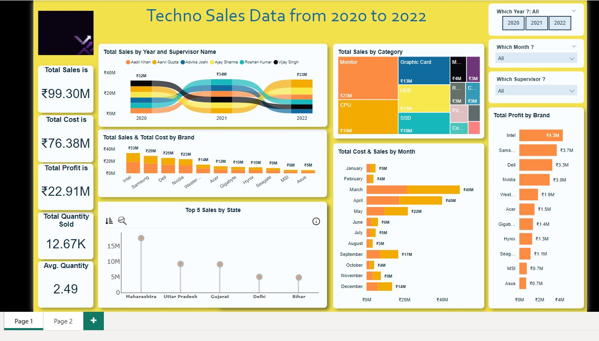

Slide 2
Insight
The total sales revenue from 2020 to 2022 amounted to ₹99.30 million. This reflects a healthy growth trajectory over the three years.
The total cost during this period was ₹76.38 million, resulting in a total profit of ₹22.91 million. This indicates a profit margin of approximately 23%, demonstrating effective cost management.
Vijay Singh was the best performer in 2020, generating sales of ₹5.6 million. However, his performance declined in 2021, maintaining the same sales figure, and he ranked second to last in 2022 with sales of ₹4.6 million.
Sales peaked in 2021 at ₹34 million, followed by a slight decline to ₹33 million in 2022. This trend indicates the need for strategies to sustain sales momentum moving forward.
The months of March, April, and May consistently emerge as the best months for sales across all years, while the rest of the year, except for September and December, shows lower sales activity.
The leading states in terms of sales performance are Maharashtra, Uttar Pradesh, Gujarat, Delhi, and Bihar, highlighting key markets for future focus.

Slide 3
Insight
The average quantity sold per transaction is decreasing, from 2.52 units in 2020 to 2.46 units in 2022, suggesting a need to encourage larger purchases.
The top three brands by total sales are Intel (₹18 million), Samsung (₹28 million), and Dell (₹25 million). Brands such as Asus and MSI show lower sales and profitability.
Monitors lead category sales with a total of ₹23 million, indicating strong demand in this segment. Higher-selling categories like monitors and CPUs should contribute proportionally higher profits.
Supervisors Aarvi Gupta and Ajay Sharma consistently contribute significantly to overall sales performance.

Slide 4
Actionable Strategy
Offer exclusive deals or bundles for these brands to boost customer loyalty and sales further.
To counter the declining average quantity sold per transaction, introduce upselling and cross-selling strategies.
Capitalize on the peak sales months of March, April, and May by launching seasonal promotions or discounts during these periods.
Recognize and reward top-performing supervisors like Aarvi Gupta and Ajay Sharma for their contributions to sales.

Slide 5
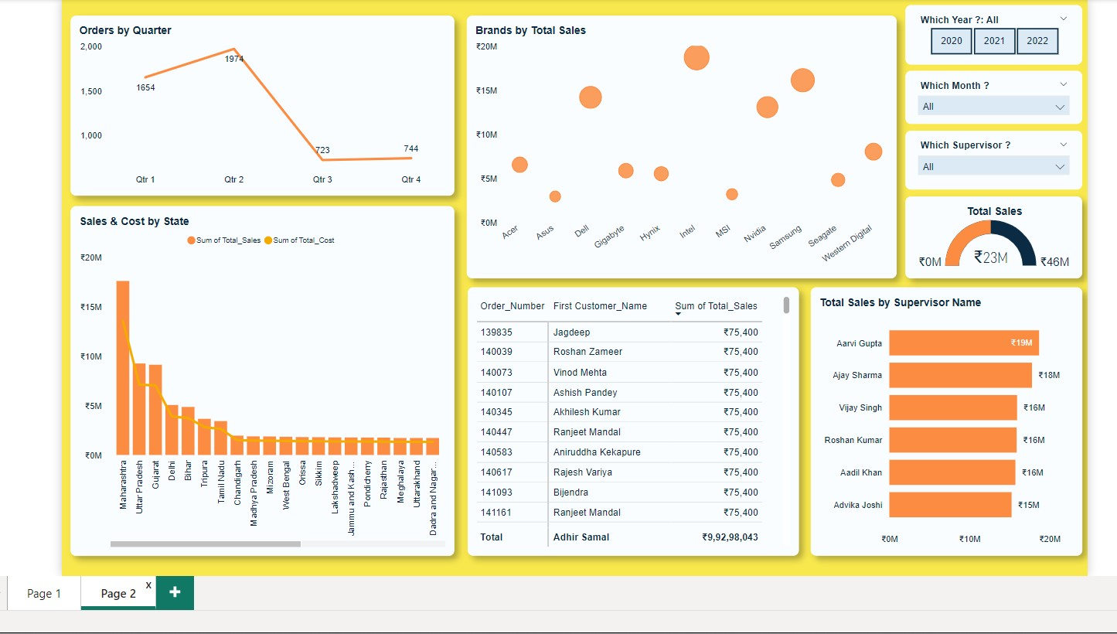

Slide 6
Insight
Quarter 2 recorded the highest number of orders at 1,974, while Quarter 3 and Quarter 4 showed significant drops with only 723 and 744 orders, respectively.
Maharashtra leads in total sales with over ₹17 million, indicating its importance as a key market.
Notable high-value customers include Jagdeep and Roshan Zameer, whose contributions significantly impact overall revenue.
States with high sales also report higher costs, indicating a direct correlation that should be monitored for profitability analysis.
Brands like Samsung, Nvidia, and Western Digital dominate overall sales figures, while brands such as MSI and Hynix are lagging behind.
Supervisor Aarvi Gupta generated the highest sales at ₹19 million, while Advika Joshi contributed the least among top supervisors at ₹15 million.

Slide 7
Actionable Strategy
Develop loyalty programs and personalized offers for high-value customers to encourage repeat business.
Share best practices from high-performing supervisors with others through training or mentorship programs.
Launch mid-year flash sales and offer incentives to stimulate orders during slower periods.

